Slide 1

Books recommendation system
Manikesavareddy
Satya Kanaka Durga
Manvitha
Hima Bindu
Sujan Kumar Das
Kiran Sai

Slide 2

Agenda
Introduction
Problem statement
Data
Collaborative filtering
Visualization of data
Results
Conclusion

Slide 3

Introduction
A recommendation system (or recommender system) is a class of machine learning that uses data to help predict, narrow down, and find what people are looking for among an exponentially growing number of options.

Slide 4

Data
Books dataset has 271360 rows and 8 columns
Ratings dataset has 1149780 rows and 3 columns
Users dataset has 278858 rows and 3 columns

Slide 5
Problem statement Book recommendation system
A book recommendation system is a type of recommendation system where we have to recommend similar books to the reader based on his interest

Slide 6
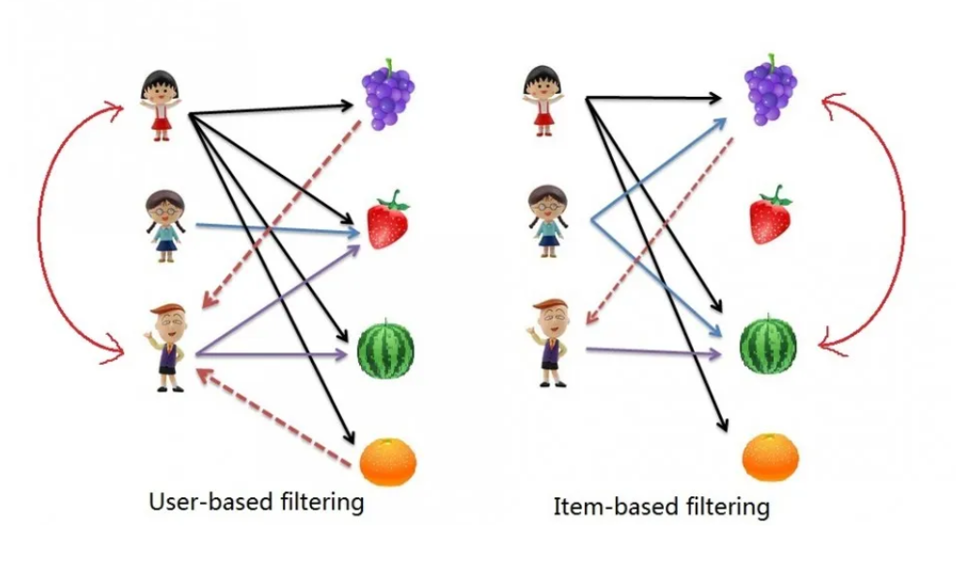
Collaborative Filtering recommends items based on similarity measures between users and/or items. The basic assumption behind the algorithm is that users with similar interests have common preferences.
User-based collaborative filtering:
Item-based collaborative filtering:
This approach identifies similar users based on their past behavior and generates recommendations for a target user based on what similar users have liked or interacted with.
This approach identifies similar items based on users' past behavior and generates recommendations by suggesting items similar to the ones a user has already shown interest in.

Slide 7
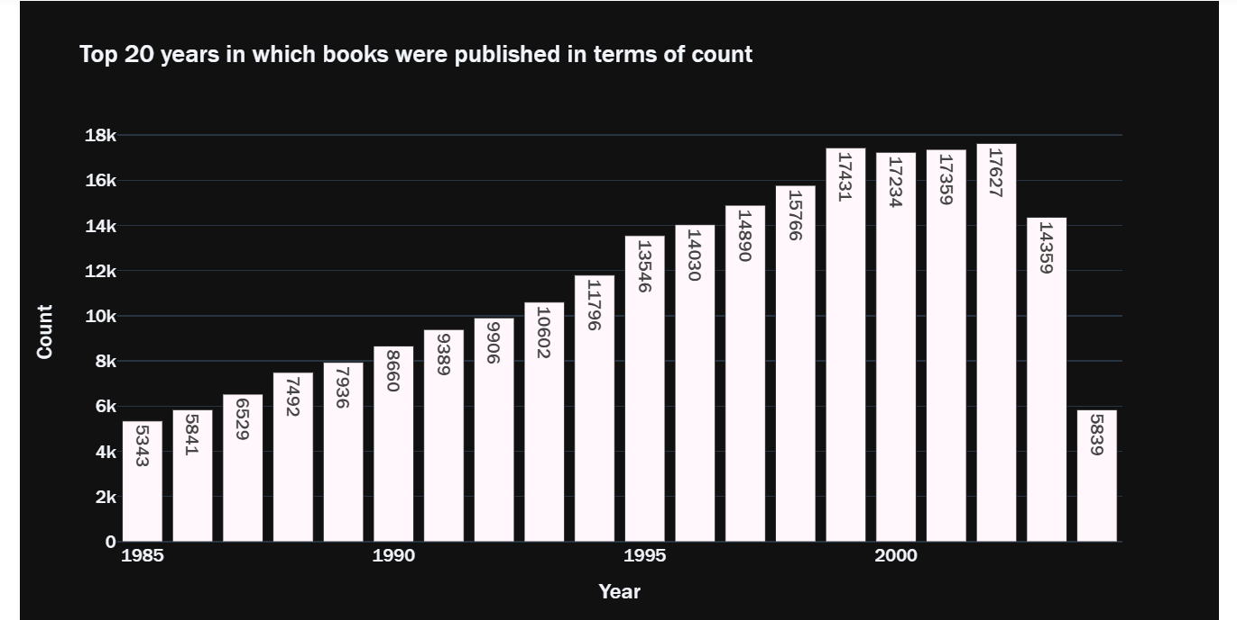
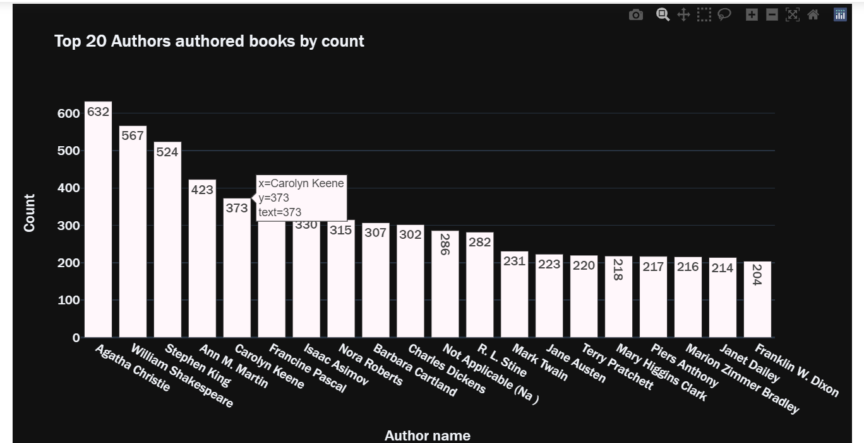
Visualization

Slide 8
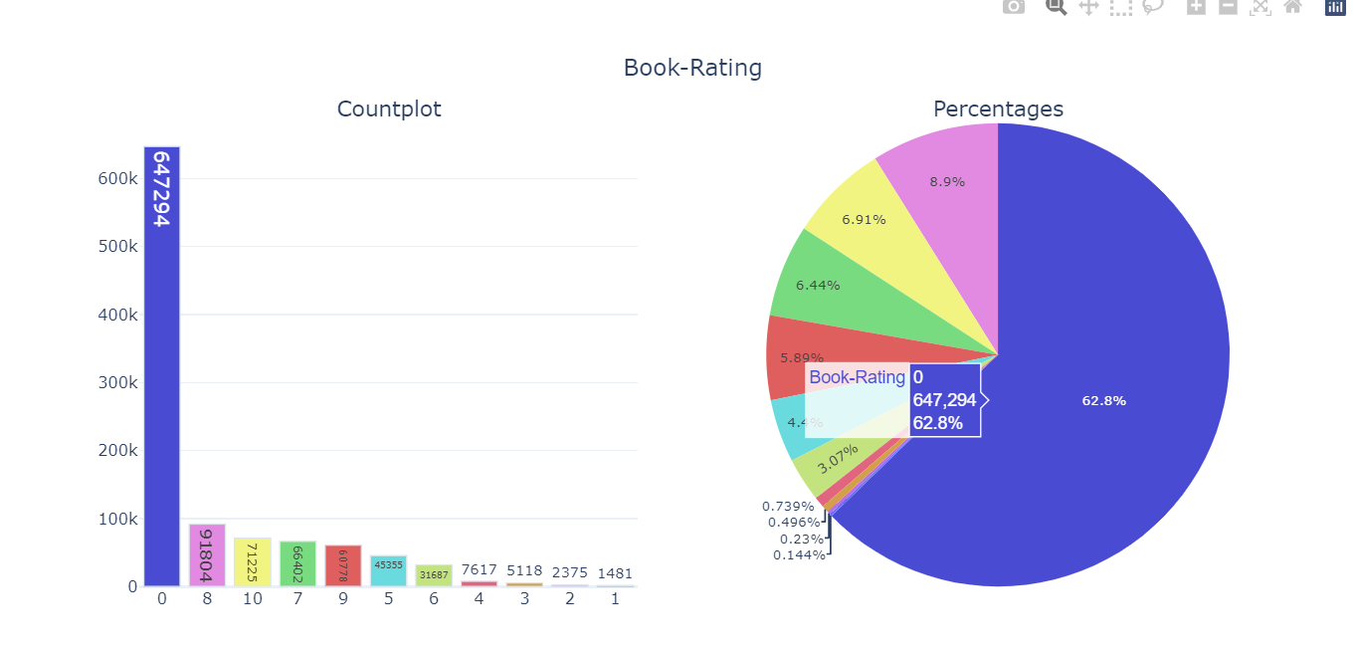
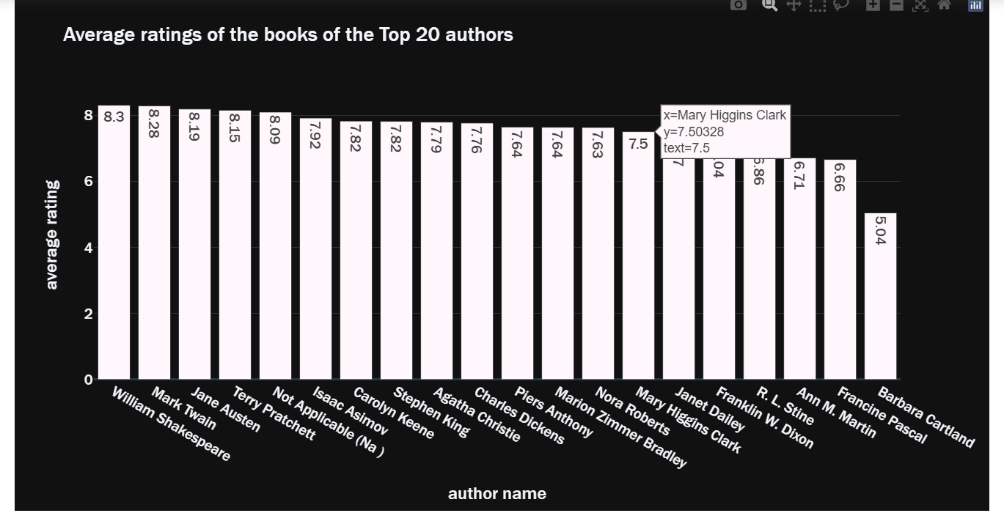
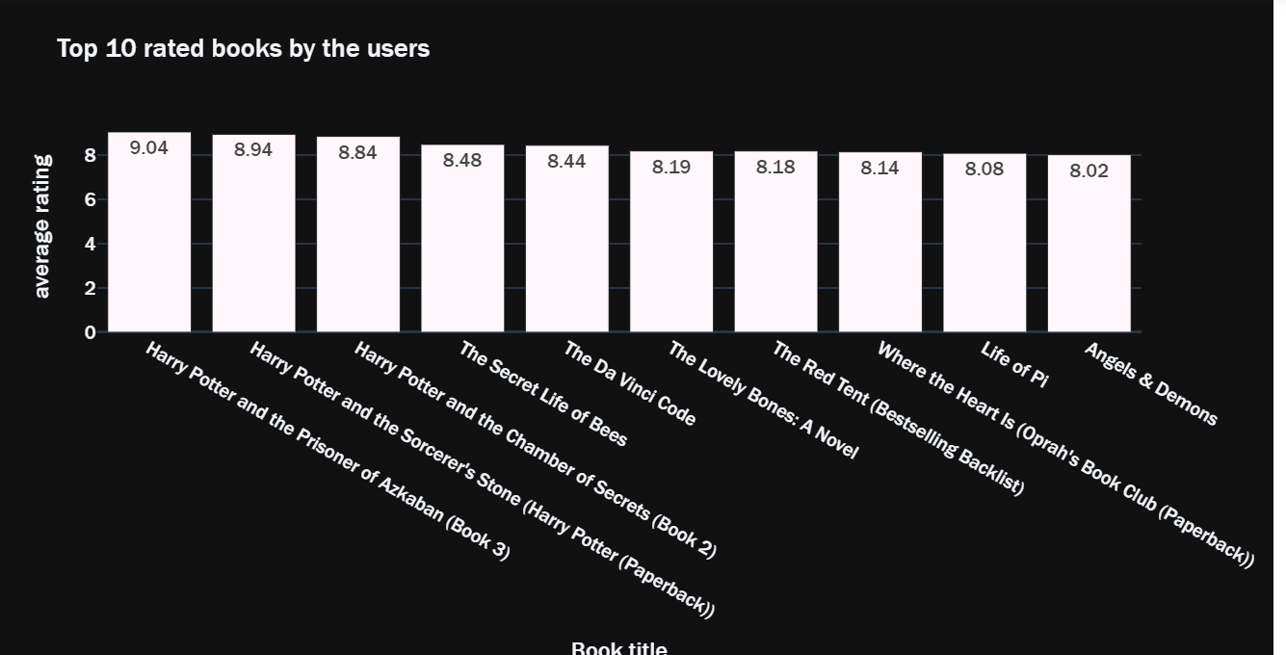

Slide 9
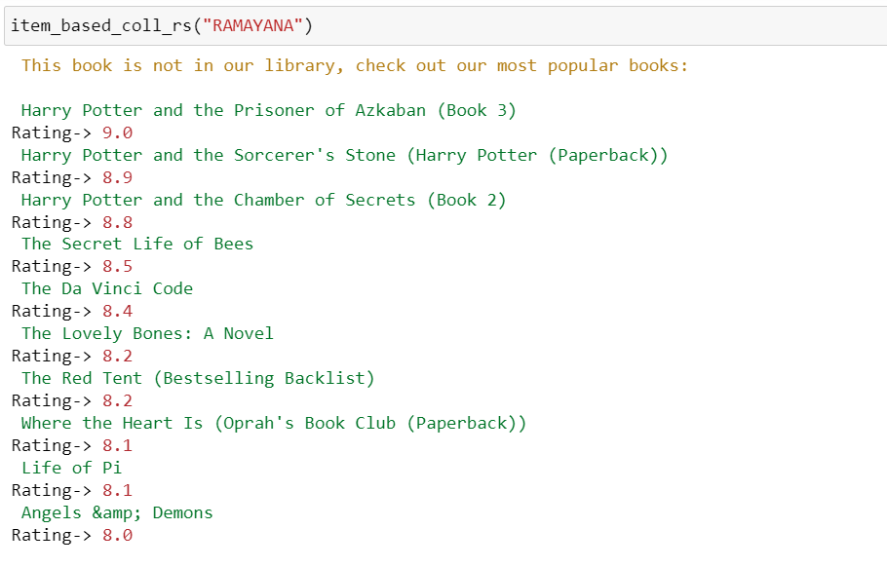
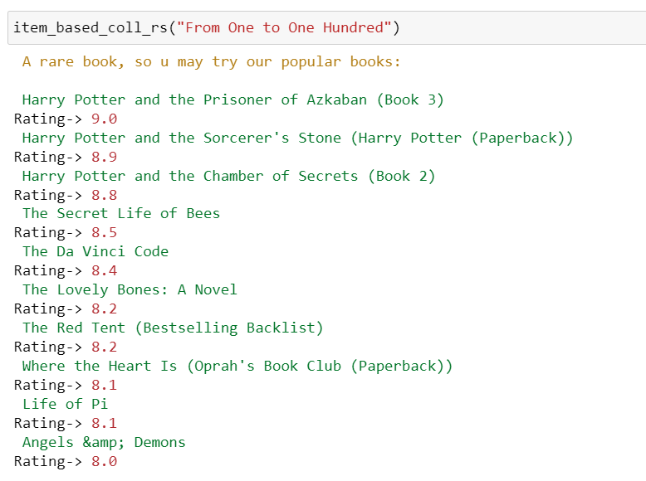
Results

Slide 10
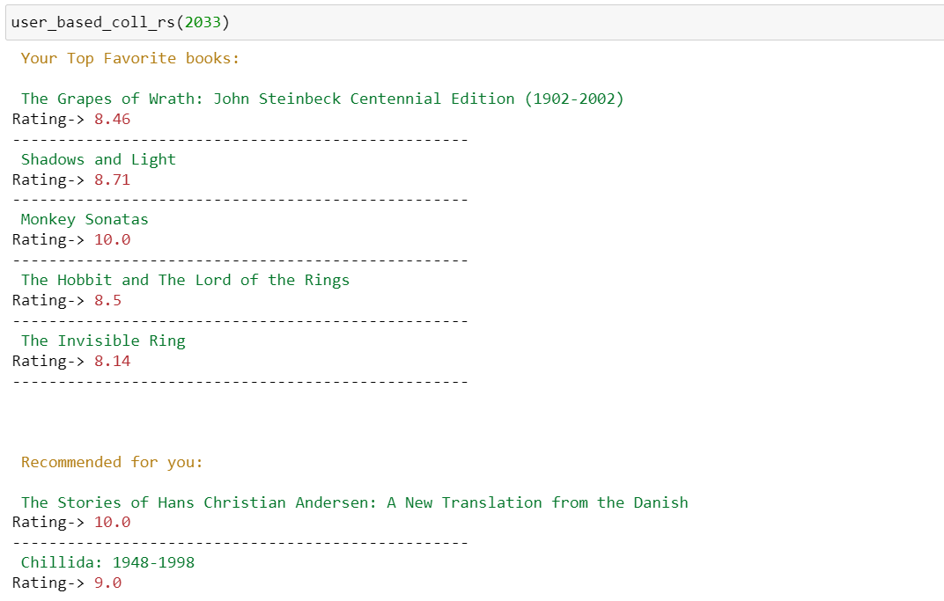
Results

Slide 11

Conclusion
In conclusion, a book recommendation system is a valuable tool for both readers and publishers. For readers, a book recommendation system offers convenience and efficiency by presenting tailored suggestions that align with their reading tastes. It saves time and effort that would otherwise be spent browsing through countless options, increasing the likelihood of finding books that resonate with their interests. Additionally, these systems can introduce readers to new genres, authors, or topics they may not have considered before, broadening their reading horizons.

Slide 12

Thank you

